Slide 1





Fund-ETH
FUND-ETH
Revolutionizing fundraising: Secure, transparent, and efficient transfer of funds using Ethereum, decentralization, and Web 3.0

Slide 2
Fund-ETH
Problem Statement
Charity fundraising using traditional methods like door-to-door and bank transfers faces transparency issues, risking fraud, accountability lapses, and inefficient fund distribution across campaigns. This problem is amplified in cross-border scenarios, where tracking funds becomes even more challenging. These issues not only erode donor confidence but also hinder the effectiveness of charity fundraising efforts, especially in the context of international campaigns.

Slide 3

Fundeth
Our Solution
1. Decentralized Trust
2. Community-Driven Allocation
3. Time-Efficient Fundraising:
We propose secure, decentralized crowdfunding platform. This solution ensures transparency and trust in fundraising activities by leveraging blockchain and smart contract capabilities, enhancing donor confidence and optimizing the effectiveness of charity funds
Introducing a special voting system for donors. so donors can work together to decide where funds go, making it fair and transparent.it will make fundraising more trustworthy and efficient.
Instead of time-consuming methods like door-to-door or bank transfers, we'll make it quick and easy. Our solution trims down the effort, making fundraising a breeze compared to traditional approaches.

Slide 4
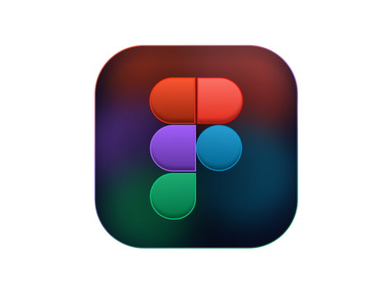





TechStack
Frontend
Backend

Slide 5
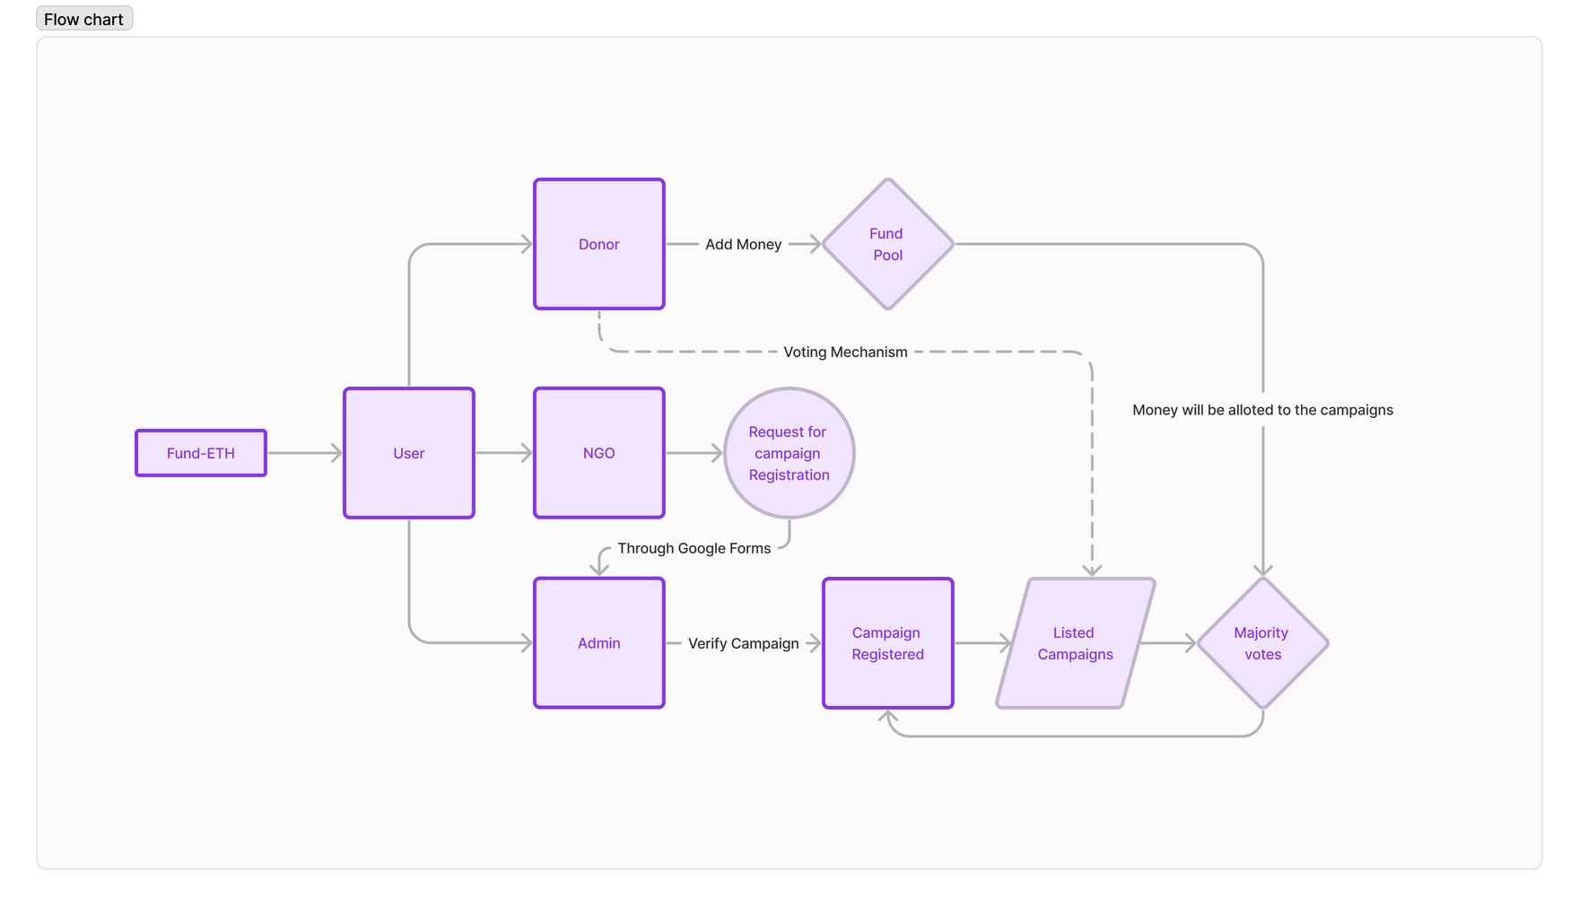
Flowchart

Slide 6
Fund ETH
The choice of addressing potential fraud and inefficiencies in traditional fundraising campaigns is critical, particularly in light of real-world instances where hard-earned money, when donated through charities, faced security and transparency challenges. Numerous news reports have highlighted cases of mismanagement and misuse of funds in charitable organizations, eroding public trust. For example, incidents of embezzlement, misappropriation, and lack of accountability have underscored the need for a more secure and transparent fundraising model.
Why you chose this problem statement?

Slide 7
Fund-ETH
What we can do more in it?
The process of verification of the campaigns is driven manually now but we can make a seamless process by using some government verification methods

Slide 8

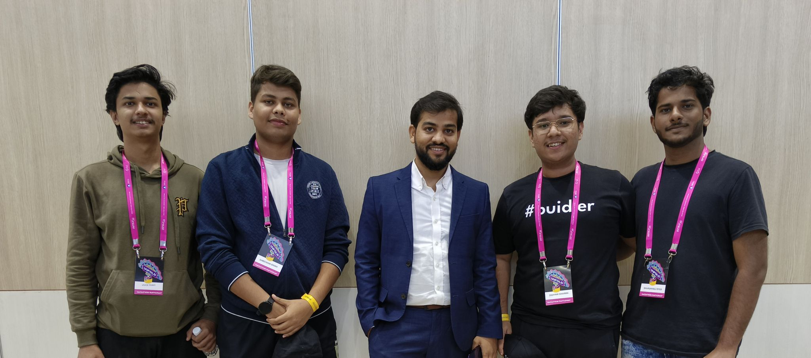


Our team
Let's meet our team members
VIVEK SHAH
SHREYASH SINGH
SWAYAM SHARMA
Web 3.0 Developer
ML Developer
Product Designer

